Slide 1
Querying Big Data with PySpark
Lesson 22.2

Slide 3
Class Objectives
By the end of this lesson, you will be able to:
Apply grouping and aggregation functions to a dataset by using Spark.
Parse and format date timestamps by using Spark.
Use temporary tables to prepare data for SQL.
Combine PySpark and SQL to run queries.

Slide 4
Grouping and Aggregating Data

Slide 5
We use the groupBy() function to group rows together, based on specific columns.

Slide 6
Aggregation Functions
PySpark makes several aggregation functions available. Here are a few:
avg()
last()
countDistinct()
max()
count()
min()
first()

Slide 7
In PySpark, we need to combine the groupBy() function with an aggregation function to return the rows that we want.

Slide 8
PCard Transactions

Slide 10
Activity: Retail Transactions
In this activity, you’ll practice using the groupBy() and agg() functions with the Retail Transaction Data dataset.
Understanding how these functions work is important, because that’s another step toward being able to transform data into various forms.
15 minutes

Slide 13
Reading and Plotting Time Series

Slide 14
Spark DataFrame Dates

Slide 15
Handling Date Formats (1 of 5)
To avoid errors when reading the data, we tell Spark to infer the schema:
inferSchema=True
We commonly encounter various date and timestamp formats.
Luckily, Spark provides a functions library that includes date and timestamp conversion functions.

Slide 16
Handling Date Formats (2 of 5)
We import the year() function, which we can use to select the year from a timestamp column:
# Import date time functions
from pyspark.sql.functions import year
# Show the year for the date column
df.select(year(df["date"])).show()
We can now create a new column that stores only the year:
# Save the year as a new column
df = df.withColumn("year", year(df['date']))
df.show()

Slide 17
Handling Date Formats (3 of 5)
With the new column, we can now group by year and find the average precipitation:
# Find the average precipitation per year
averages = df.groupBy("year").avg()
averages.orderBy("year").select("year", "avg(prcp)").show()

Slide 18
Handling Date Formats (4 of 5)
We can also use the month() function to select the month from a timestamp column:
# Import the month function to get the month from the "Date" column.
from pyspark.sql.functions import month
df.select(month(df['Date'])).show()
And, create a new column that stores only the month:
# Add a column, "month" to the DataFrame.
df = df.withColumn("month", month(df['date']))
df.show()

Slide 19
Handling Date Formats (5 of 5)
We can create a new DataFrame for the maximum precipitation:
# Get the maximum precipitation for each month.
max_ppt = df.groupBy("month").max()
max_ppt.orderBy("month").select("month", "max(prcp)").show()
And, convert the Spark DataFrame to a Pandas DataFrame:
# Import the summarized data to a Pandas DataFrame for plotting.
pandas_df = max_ppt.orderBy("month").select("month", "max(prcp)").toPandas()
pandas_df.head()

Slide 20
Plotting Time Series Data (1 of 2)
With the Pandas DataFrame, we can use Plotly to create a bar graph of the data.
import plotly.express as px
# Create a Plotly graph.
fig = px.bar(x=pandas_df['month'], y=pandas_df['max(prcp)'])
fig.update_layout(xaxis_title='Month', yaxis_title='Max Precipitation')
fig.show()

Slide 21
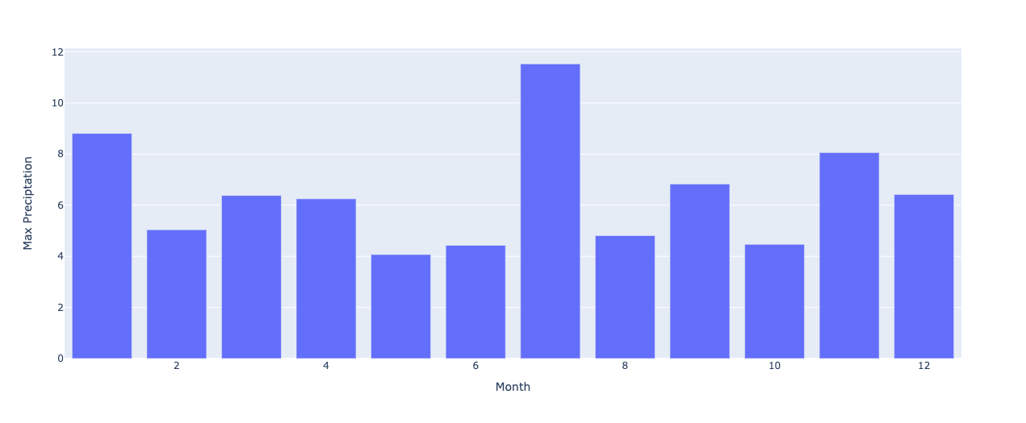
Plotting Time Series Data (2 of 2)
The bar graph of max precipitation per month:

Slide 23
20 minutes
Spark Operations
In this activity, you’ll first use Spark and Pandas to clean a bigfoot time series dataset, and you’ll then create a plot.

Slide 24

Spark SQL
Today, we’ll transition to using Spark SQL with Spark.
SQL
One of the primary goals of the Spark development team is to make Spark easy to use for people in various roles. And, almost every data professional is familiar with SQL
The Spark engine has a query optimization engine (named Catalyst optimizer) that creates a plan for how to run the SQL code.
We’ll both rewrite some of our earlier activities and write new ones with fresh data.

Slide 27
Creating Spark Temporary Tables

Slide 28
One one of the many advantages of Spark is the ability to write code against it by using various APIs— all of which perform in a similar way.

Slide 29

What’s a Temporary Table?
A temporary table, or temporary view, provides a way to lazily load a Spark table into memory.
Lazy loading doesn’t mean slow.
Lazy loading means not completely loading anything until it’s needed.
So, applications typically run faster.
‹#›
Notes:
shutterstock_215637262

Slide 30
Temporary Tables
Once we load a temporary table, we can query the table with SQL statements to produce rapid results.
It’s important to differentiate a global temp view from a local temp view.
To do so, we’ll discuss the Spark Application and the Spark Session.
https://codingsight.com

Slide 31
When you define Spark on your system, you first create a Spark Application.

Slide 32
A Spark Application can hold one to many Spark jobs, views, and Sessions.

Slide 33
Global Temp Views
All the Sessions in that Spark Application can access a global temp view.
Until the application is stopped or the table is explicitly removed, a global temp view remains accessible to all parts of the application.
We create a global temp view with the following command:
df.createOrReplaceGlobalTempView(<viewName>)
‹#›

Slide 34
Local Temp Views
Other jobs or sessions can’t access a local temp view. This can be helpful when we want to limit the scope of a session to a specific task..
We create a local temp view by using the following command:
df.createOrReplaceTempView(<viewName>)
‹#›

Slide 35
Creating a Temporary Table

Slide 37
Activity: Amazon Vine Temporary View
In this activity, you’ll import an Amazon Vine dataset, create a temporary table, and then use Spark SQL to run queries on the temporary table.
15 Minutes

Slide 40
Combining PySpark with Spark SQL

Slide 41

Combining PySpark with Spark SQL (1 of 3)
Now that you’re familiar with both the PySpark and Spark SQL frameworks, it’s time to bring them together to provide some flexibility when querying data.
SQL

Slide 42



Combining PySpark with Spark SQL (2 of 3)
One of the best features of the Spark framework is that we can easily switch among querying styles and languages.
The Spark infrastructure is built to accommodate dedicated Spark users, SQL enthusiasts, and Python programmers alike.
‹#›

Slide 43

Combining PySpark with Spark SQL (3 of 3)
Regardless of which language or part of the Spark infrastructure we prefer, the performance of all the parts of the Spark infrastructure is the same.
The Spark engine optimizes XXX based on what you’re doing and not on which language you’re using.
While coding in Spark, people commonly switch between languages.
‹#›
Notes:
shutterstock_225035317

Slide 44
Combining PySpark with Spark SQL

Slide 46
Activity: Earn a Medal in Spark SQL
In this activity, you’ll evaluate a dataset that contains Olympic athlete data by using Spark SQL.
20 Minutes

